Slide 1
Teen Substance Abuse: Medical Aspects
Dr. David Smith, Dr. Chris Cunningham,
Dr. Mike Concannon, Doug Rogers

Slide 2
Teen Substance Abuse: Medical Aspects
Over 96% of all drug deaths in Canada (2014) were caused by tobacco and alcohol.
All deaths in CDN caused by drugs = 47 007 (2006)
Deaths from Tobacco = 37 209 + deaths from Alcohol = 8103 = 45 312
45 312 divided by 47 007 = 96% (CCSA, 2014)
Both legal and easy for kids to obtain.

Slide 3
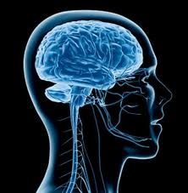
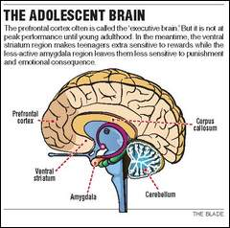
Teen Brain Development
Notes:
- Prefrontal Cortex, Limbic System (emotions), Ventral Striatum Area (Reward System), Hormones – all gas pedal and no breaks.
Home Entertainment System – Flat Screen, PVR, DVD, CD, Tuner, Speakers, no remote control yet
Adolescence is a crucial period both of susceptibility to the rewards of drugs and of vulnerability to the long-term effects of drug exposure.
Adolescence is a time of major brain development—particularly the maturation of prefrontal cortical regions involved in self-control and the neural circuits linking these areas to the reward regions. The prefrontal cortex, where we make decisions and comparative judgments about the value of different courses of action, is crucial for regulating our behavior in the face of potential rewards like drugs and food. Adolescents are prone to risky behaviors and impulsive actions that provide instant gratification instead of eventual rewards. In part, this is because their prefrontal cortex is still a work in progress. Nora Volkow

Slide 4
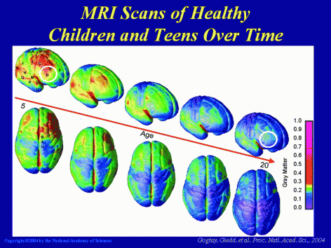
Late Frontal Lobe Development – critical to executive functioning (planning, decision making, judgement, impulse control, etc.)
Notes:
This image illustrates brain development through early adulthood, with blue indicating the mature state. The prefrontal cortex (white circle), which governs judgment and decision-making functions, is the last part of the brain to develop. This may help explain why teens, who are more prone to participating in risk-taking behavior, are particularly vulnerable to drug abuse.

Slide 5
What a Difference a Year Can Make!
Early Alcohol and Marijuana Use Among 16-18 year old BC Students – McCreary Centre Society
Fourth BC Adolescent Health Survey (ea. 5 yrs)
29,000 Youth, 2008

Slide 6
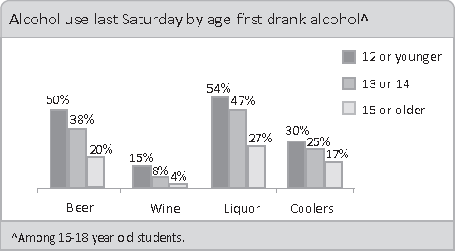
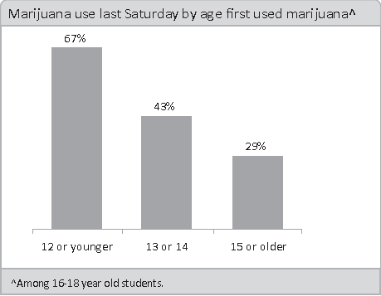
Risks of Earlier Use

Slide 7
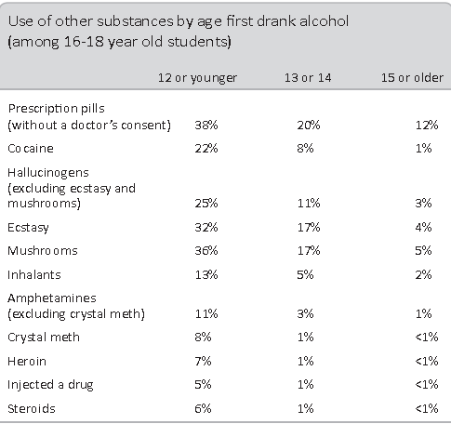

Slide 8
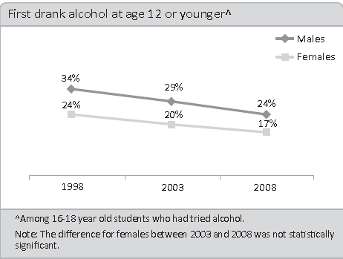
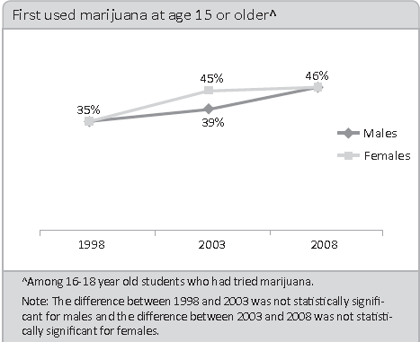
HOPE

Slide 9
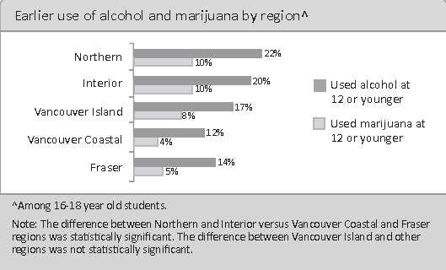

Slide 10
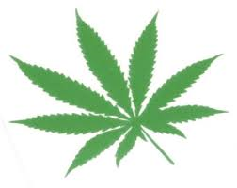
MARIJUANNA – FACT BASED
RESEARCH
The short-term effects of marijuana include (NIDA 2014):
problems with memory and learning
distorted perception (sights, sounds, time, touch)
trouble with thinking and problem-solving
loss of motor coordination; and
Increased heart rate.
These effects are even greater when other drugs are mixed with the marijuana; and users do not always know what drugs are given to them.

Slide 11
What is the effect of cannabis use on brain?
(UNODC World Drug Report, 2014)
- Cannabis affects your brain directly.
- Cannabis use can lead to problems with thinking and problem solving; it is linked to deficits in memory, attention, reaction time, information processing and learning.
- The use of Cannabis increases the risk of a series of attitude and personal changes, anxiety and depression .
- Among people who used Cannabis regularly before age 18, but then stopped the use, a reduce in IQ by 8 was observed by age 38 – 20 years after the use.

Slide 12
Many people use cannabis during the teenage years – it must be harmless?
(UNODC World Drug Report, 2014, Mentorfoundation.org, 2014)
- The adolescent brain is not fully developed until the mid-20s and developing brains are much more vulnerable to all negative effects of cannabis use.
- Important cognitive functions, resulting in skills such as regulating your emotions, making decisions, solving problems and abstract thinking, may not mature if this delicate development process is disrupted by drug use.
- Early initiation and intense use during teen age years increases the risk of dependence.
- The likelihood to become addicted if anyone begins using cannabis in adolescence almost doubles (1 out of 6 instead 1 out of 10).
- Early initiation and use during teen age years is also associated with problems in psychosocial development, mental health and poorer cognitive performance.

Slide 13
Alcohol and Teens:
Teens versus Adults. What’s the Difference?
A young person’s body cannot cope with alcohol the same way an adult’s can.
Drinking is more harmful to teens than adults because their brains are still developing throughout adolescence and well into young adulthood. Drinking during this critical growth period can lead to lifelong damage in brain function, particularly as it relates to memory, motor skills (ability to move) and coordination.
According to research, young people who begin drinking before age 15 are four times more likely to develop alcohol dependence than those who begin drinking at age 21.
For some teens, drinking seems to be a solution to problems they don’t want to face (NIDA, 2014).

Slide 14
Smoking Impact on Canadians
Smoking in Canada
  ~ 5million = 16 % adult population ( > 15yr)
  4-6% (13-15), 10% (15-19), 22% (25-34)
  Males > Females BC 13%
    ( 25% in 1999) ..but slowing
  Death
  #1 preventable cause of death in Canada.
  50% of all die < 70 yrs
  22% all death are from smoking
  37,000 die/yr = Boeing 737 crash / day
  (BC 6000 …. China 1.2 mil )

Slide 15
Impact on Canadians
14,000 smokers developed lung CA /yr
361 non-smokers developed lung CA
lung, esophagus, larynx, mouth, throat, kidney, bladder, pancreas, stomach, cervix, acute myeloid leukemia
Smoking is the single preventable cause of lung CA
  85% of all new cases
Smoking is directly connected to 24 diseases
  18 of which are fatal

Slide 16
Know how to use it !
Smoking is the only legal substance
which when used correctly
kills > 50% of those using

Slide 17
Deaths Prevented or Postponed Through Risk-Factor Reduction
Study of coronary heart disease deaths in England
Quitting
Smoking
Cholesterol
Reduction
Blood Pressure
Reduction
Unal B et al. BMJ 2005;331:614Cessation > Supersize & KFC & couch
Notes:
Key Point:
Along with cholesterol and blood pressure reduction, quitting smoking is a critically important risk factor to manage in postponing or preventing CHD-related deaths.
Background:
This study by Unal and colleagues investigated the potential impact of population-based primary prevention measures (in healthy individuals) versus secondary prevention efforts of risk factor reduction in patients with CHD on cardiovascular health in England and Wales. They constructed a model that synthesized data on the number of CHD patients, use of specific treatments, trends in cardiovascular risk factors, and mortality benefits of specific risk factor changes in healthy people and in CHD patients. In the healthy population, the single largest factor contributing to the reduction in CHD mortality rates in 1981-2000 was quitting smoking. Over this time period, CHD mortality actually declined by 54%, and smoking prevalence fell by 35%. Quitting smoking resulted in the prevention or postponement of about 24,680 deaths – a substantially higher amount than the deaths prevented/postponed by cholesterol reduction (n=4710) and blood pressure reduction (n=7235).
Reference:
Unal B, Critchley JA, Capewell S. Modelling the decline in coronary heart disease deaths in England and Wales, 1981–2000: comparing contributions from primary prevention and secondary prevention. BMJ 2005;331:614.

Slide 18

2nd hand smoke

Slide 19
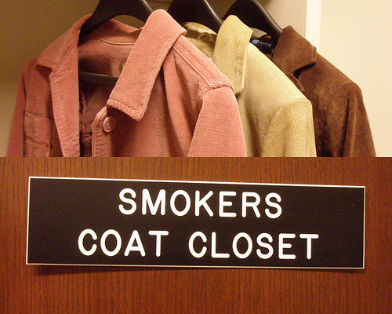
3rd hand smoke

Slide 20
Some facts on teen smoking
Each day, between 82,000 and 99,000 young people around the world start smoking.
Almost 4-6 % Canadian teens (aged 12-19) currently smoke (daily or reg) start 13yr ( 2013). 24% “ever tried” (2013)
In Canada, the smoking rates are generally higher among males than females. ( Aboriginals higher )
Youth smokers make more attempts to quit smoking than adult smokers.

Slide 21
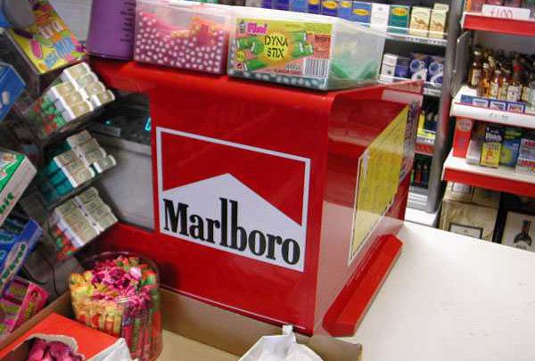

Slide 22
E Cigarettes regulations
Health Canada, BC Health Authorities, The World Health Organization, Schools and others, have all advised the public against using e-cigarettes.
E-cigarettes that contain nicotine are not authorized for sale in Canada. Advertising e-cigarettes as a cessation tool or NRT is not permitted.
Despite this the devices themselves can be sold legally, as can liquid that does not contain nicotine. But easy to purchase nicotine-based liquid on the internet or illegally in non-compliant stores.

Slide 23
2014 Monitoring the Future (MTF) survey,
- National Institute on Drug Abuse (NIDA)
Cigarette smoking has decreased but
e-cigarettes has increased among teens.
e-cigarettes:
Past-month use 8th graders is 8.7 %,
10th graders is 16.2 %
12th graders is 17.1 %.

Slide 24
2013 CDC -journal Nicotine and Tobacco Research.
E-cigarette use teens ( never smoked tobacco) USA
3x increase, from about 79,000 (2011), to 263,000 (2013).
2011 - 2013 National Youth Tobacco surveys
youth (never smoked tobacco cigarettes) but who ever tried
e-cigarettes were 2x as likely to have intentions to smoke cigarettes as those who had never used e-cigarettes. 43.9% vs 21.5%
Hence : > 250,000 youth used e-cigs and are 2x likely to smoke tobacco eventually

Slide 25
Canadian Cancer Society
(Quebec)
2012-2013 school year,
1/3 of secondary school students reported already having used e-cigarettes.
9% students in Grade 6 had tried e-cigarettes.
41% in grade 11 had tried e-cigarettes.
"Flavours such as chocolate, candy and fruit appeal to children and youth, ...a potential gateway to smoking. E‐cigarettes also undermine the efforts of youth who are trying to quit, by renormalizing smoking in the school environment for minors”

Slide 26
E Cigarettes in the news
Globe & Mail Oct. 08 2013
“E-cigarettes could hook a new generation on nicotine, experts warn”
fruit-flavoured products, movie star endorsements
lure youth who wouldn’t otherwise smoke
reminiscent of the imagery and allure once employed to sell conventional cigarettes to young people
And false...“here’s a cigarette that doesn’t have all the bad stuff”
Calls to poison-control centres are on the increase

Slide 27
Chemicals e-cigarettes
Nicotine - addictive (pulmonary) , affects fetuses, brain development, extremely toxic , skin contact
Vaping - production of heavy metals, chromium, nickel, carcinogens like formaldehyde at levels that can be even higher than those found in conventional cigarettes.
devices can generate large quantities of fine particulate matter that can not only carry toxins deep into the lungs, exacerbate pre-existing lung conditions such as asthma or chronic obstructive pulmonary disease.
e-juice flavourings and propylene glycol, are established irritants to lungs.

Slide 28
Vaping Chemicals
E-liquid contains
propylene glycol (PG), (theatre fog) a common food additive and flavouring. While PG is considered safe for oral consumption, the health risks of inhaling PG deep into the lungs is unknown.
vegetable glycerin (VG), polyethylene glycol 400
e-cigarettes aren’t going to be safe for long-term use
If the battery is too high, you can get combustion. And as soon as you get combustion then you get a different set of chemicals, which starts to look closer to what’s in actual smoke,“

Slide 29
E-cigarettes overview
lack of quality control in manufacturing the product (products labelled as being nicotine-free have been found to contain nicotine)
Replacement cartridges and E-liquid of inaccurate concentrations, poor quality and poor labeling
Leakage
Presence of toxic impurities
May attract and hook non-smokers
Flavoured products especially attractive to youth
May contribute to the “renormalization” of cigarette use

Slide 30
The $1M Question
So what can I do, as a concerned parent/family member, to best immunize my child against drug abuse or to help them if I suspect they are already involved?

Slide 31
Resiliency
Risk Factors
Protective Factors
biological processes
personality traits
mental health disorders
family neglect and abuse
poor attachment to school and the community
favourable social norms and conducive environments to drug abuse
growing up in marginalized and deprived communities.
Source: UNODC -International Standards on Drug Prevention, 2014.
psychological and emotional well-being
personal and social competence
a strong attachment to caring and effective parents
strong attachment to schools and communities that are well resourced and organized
Notes:
- Not just about a lack of knowledge about drugs and their consequences.
Resiliency – the ability to cope with adversity or a situation that is not readily amenable to change (ie living with an alcoholic parent) (Compendium of Best Practices pg. 23)
Strength Based.
- Favorable social norms – mass media, parental role models, perceived risk, availability/price, peers
-It is important to emphasize that these risk factors referenced above are
largely out of the control of the individual (nobody chooses to be neglected by
his/her parents!).
They are also linked to many other risky behaviours and related health
disorders, such as dropping-out of school, aggressiveness, delinquency,
violence, risky sexual behaviour, depression and suicide. It should not,
therefore, come as a surprise that prevention science demonstrates that many
drug prevention interventions and policies also prevent other risky behaviours.

Slide 32

Connectedness - Family
Enhance family bonding, i.e. the attachment between parents and children;
Source:UNODC, 2014. pg. 16
Notes:
The Single Most Important Factor!
Parenting skills programmes support parents in being better parents, in very
simple ways. A warm child-rearing style, where parents set rules for
acceptable behaviours, closely monitor free time and friendship patterns, help
to acquire skills to make informed decisions, and are role models has been
shown to be one of the most powerful protective factors against substance
abuse and other risky behaviours.
The Authoritative Parent – Diana Baumrind; high on structure and high on warmth and support.
Emotion Coaching - John Gottman, PhD (The Science of Trust)
[NIDA:
Principle 5 - Family-based prevention programs should enhance family bonding and relationships and include parenting skills; practice in developing, discussing, and enforcing family policies on substance abuse; and training in drug education and information (Ashery et al. 1998).
Family bonding is the bedrock of the relationship between parents and children. Bonding can be strengthened through skills training on parent supportiveness of children, parent-child communication, and parental involvement (Kosterman et al. 1997; Spoth et al. 2004).
Parental monitoring and supervision are critical for drug abuse prevention. These skills can be enhanced with training on rule-setting; techniques for monitoring activities; praise for appropriate behavior; and moderate, consistent discipline that enforces defined family rules (Kosterman et al. 2001).
Drug education and information for parents or caregivers reinforces what children are learning about the harmful effects of drugs and opens opportunities for family discussions about the abuse of legal and illegal substances (Bauman et al. 2001).
Brief, family-focused interventions for the general population can positively change specific parenting behavior that can reduce later risks of drug abuse (Spoth et al. 2002b).]

Slide 33
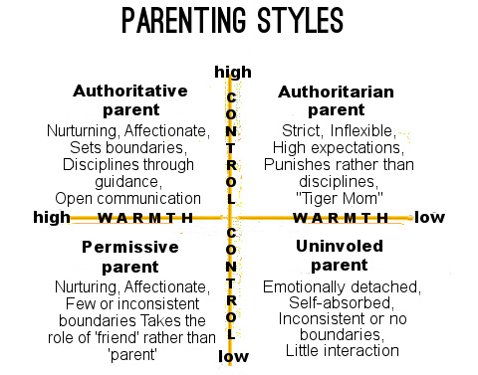

Slide 34
Our Role As A Concerned Parent
Talk with your children about drugs. Explain how taking drugs can hurt their health, their friends and family, and their future. Tell them you don't want them to do drugs.
Be a part of their lives. Spend time together. Even when times are hard, kids can make it when they know that the adults in their life care about them.
Know where your children are and what they're doing. Keeping track of your children helps you protect them. It gives them fewer chances to get into drugs.
Set clear rules and enforce them fairly. Kids need rules they can count on. That is how they learn for themselves what is safe and what can get them in trouble.
Be a good example for your children. You might not think so, but kids look up to their parents. Show them how you get along with people and deal with stress, so they can learn how to do it.
Teach your children how to refuse drugs. Kids often do drugs just to fit in with the other kids. Help them practice how to say no if someone offers them drugs.
Make your home safe. Do not have people in the house who abuse drugs and alcohol. Keep track of medicines and cleaning products.
Source: NIDA

Slide 35
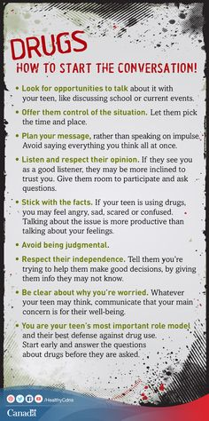

Slide 36
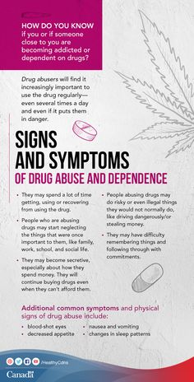

Slide 37
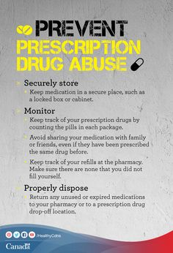

Slide 38
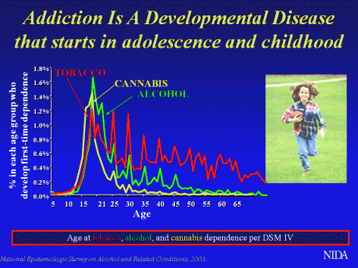

Slide 39


Slide 40
Resources
http://healthycanadians.gc.ca/alt/pdf/healthy-living-vie-saine/substance-abuse-toxicomanie/talking-parle/teens-adolescents-eng.pdf
http://www.drugabuse.gov/family-checkup
Your Family Doctor
Your School Counselor
Vernon Mental Health
Vernon Child and Youth Mental Health

