Slide 1
Adolescence and Substance abuse
Talking to your teens about drugs and alcohol
  Dr. Marvin Krank
  UBC

Slide 2
What we will talk about
Why you should talk to them
What you say and do matters
Why teens are different
What to say and do
How and when to say it

Slide 3
Why you should talk to them about drugs and alcohol
There are many potential dangers and negative outcomes to using substances
Difficult time of physical, emotional, social, and neurological transitions
They need guidance and support

Slide 4
Scope of the problem

Slide 5
Why we should care

Slide 6
Early and heavy alcohol use is correlated with many negative outcomes
Health
  Aches and pains
  Accidents
  Hospitalization
Violence
  Victim
  Perpetrator
  Various kinds
    Bullying
    Dating violence
Sex
  Early sex
  Regretted sex
  Sexual assault
Problem behaviours
Skipped school
Stayed out all night without parent permission
Damaged property
Warned or detained by police
School detention
Stole something outside of home
Stole at home
Suspended out of school
Suspended in school
Ran away from home
Carrying weapons

Slide 7
What you say and do matters
Transition to external focus – peers over parents
Experimentation and independence, but still need a safe haven
Contrary to appearances they need you more than ever

Slide 8
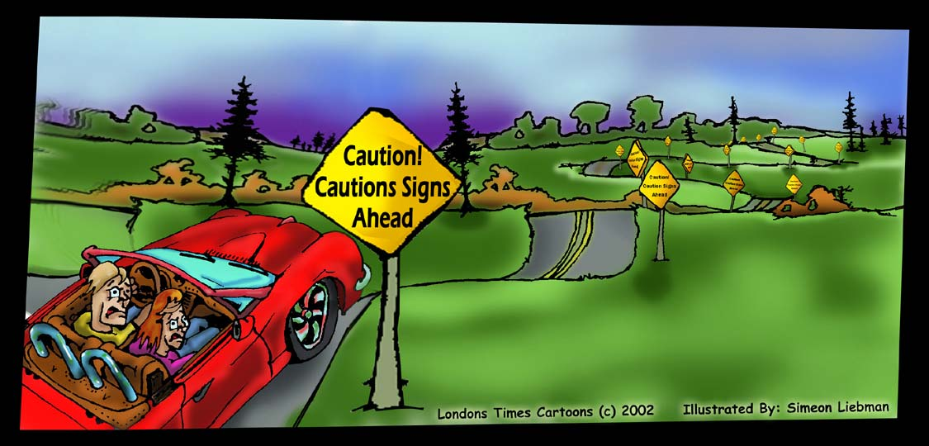
How can we help youth get through these perilous times

Slide 9
How and when should we talk to our kids:
How do we best prepare our kids to face these risky decisions?
How many Psychologists does it take to change a light bulb?

Slide 10
Teens are different than adults and children
New developmental tasks – becoming and adult
Brain development – Growth of executive functions
More
  external focus
  interaction with peers
  opportunities and incentives to take risks
Less
  family contact
  protection and safety
More
  sensitive to reward – sensation seeking
  emotionally reactive
  impulsivity
Less
  future orientation
  planning and deliberation
  ability to hold back

Slide 11
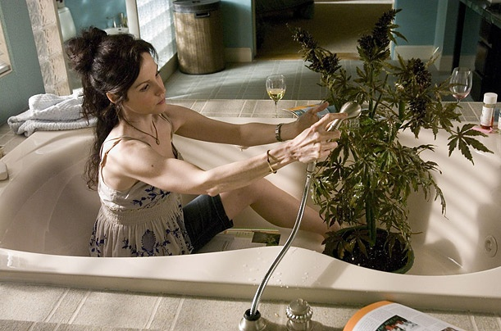
Individual differences in Substance use risk and protective factors
Social learning
  Parental use and tolerance of use
  Peer use
  Popular culture
  Violence/Neglect
Personality/Genetic/Developmental moderators
  Impulsivity/Executive control
  Sensation-seeking/Dopamine risk alleles (DRD2/DRD4/DAT1)
  Hopelessness
Cognitive mediators
  Expectancies
  Substance use associations
Use of drugs and alcohol
Weeds

Slide 12

It starts here: Cognitive predictors of individual differences
Memory that matters
draft beer
party
have fun
drink alcohol

Slide 13
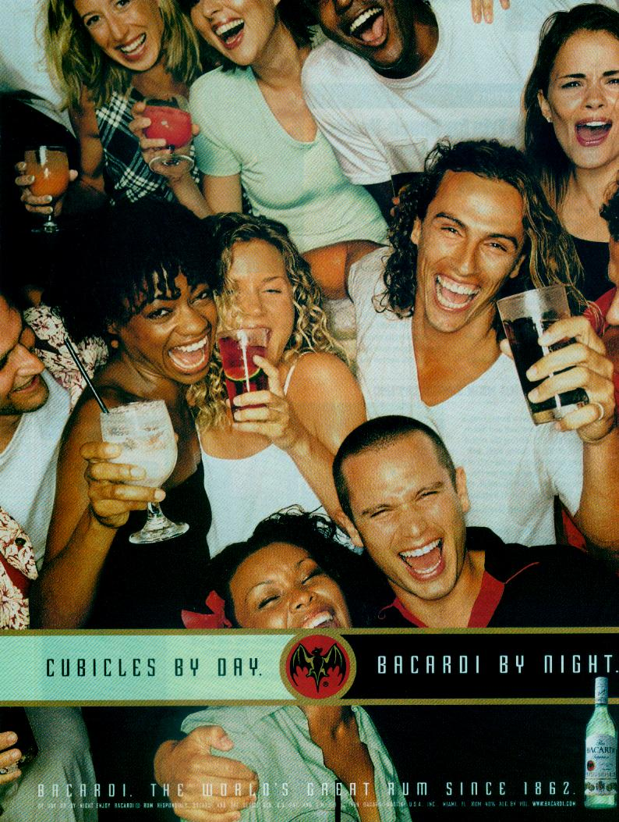
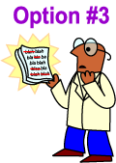
Memory and choice: What kind of information are important
Two critical pieces of information
  Outcomes (Motivation): Incentive
    What will happen in a situation or if I do something?
  Options (Menus): Behavioural alternatives
    What can I choose to do in a given situation?

Slide 14
Write the first word that comes to mind after each word shown
hoe
weed
stick
mug
rock
kitchen
draft
knife
bottle
pot
Alcohol Homographs
Marijuana Homographs

Slide 15
Associations and risk

Slide 16
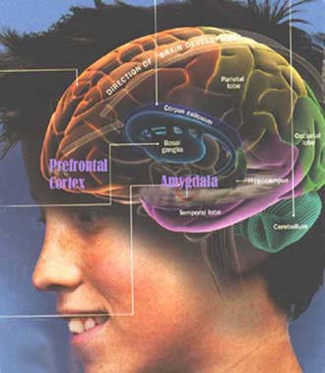
Teen brains are different

Slide 17
Impulsivity
What helps?
Improved control and decision-making skills
Future plans

Slide 18

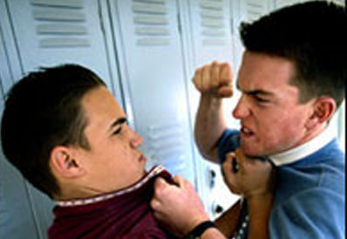
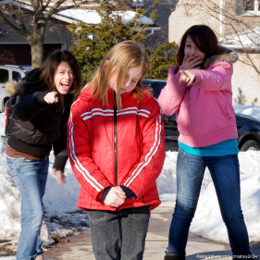
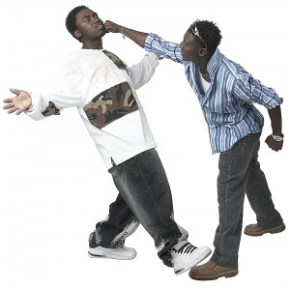

Slide 19
Violence
What helps?
Attention and support
Activities that support coping with the impacts

Slide 20

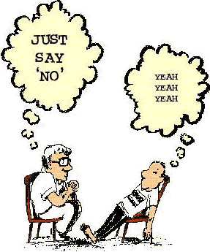




What can we do:
Just say no?

Slide 21
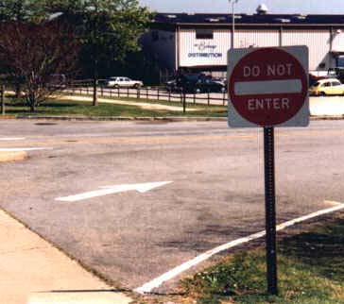
Mixed messages:
We need to tell them more than what not to do!

Slide 22
What to say and do: six simple rules
Model low risk behavior
Set clear no substance use expectations
Monitor: Ask about where they are going, who they are going with, and what the are going to do.
Be supportive; listen and empathize
State the risks and encourage healthy alternatives
Accept mistakes as learning experiences; recognize their limitations

Slide 23
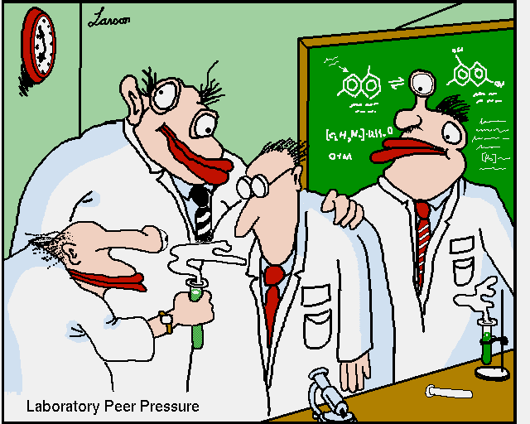
Parent and peer influences

Slide 24
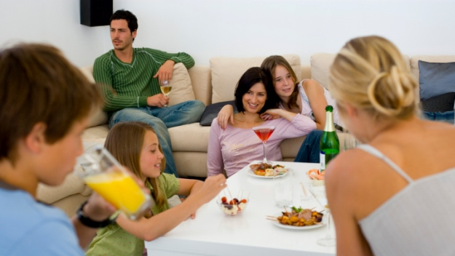
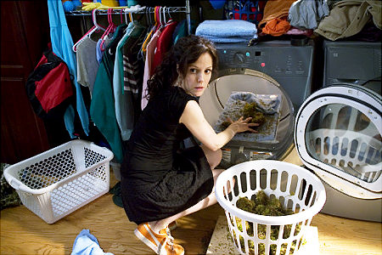
Be a good role model
If you drink, drink moderately!
If you smoke, quit or at least don’t smoke in front of your children

Slide 25
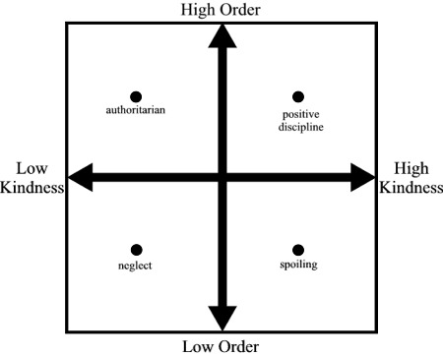
Parental style: which style is most effective?
It is how you say no that is important

Slide 26

Set clear expectations of no substance use

Slide 27


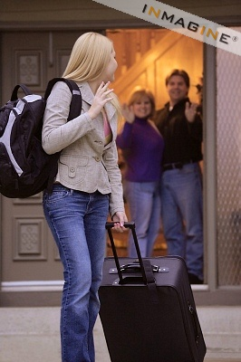
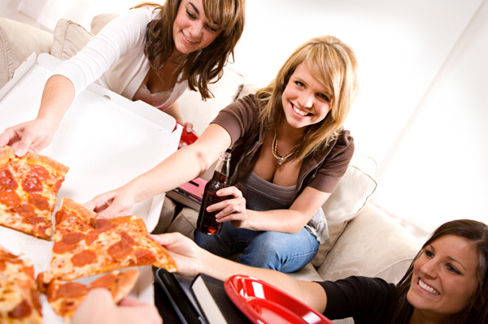
Monitor, but don’t meddle

Slide 28
Parent-Child Balance
Parental Expectations
Independent Decision Making

Slide 29
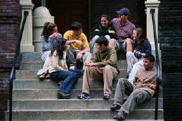
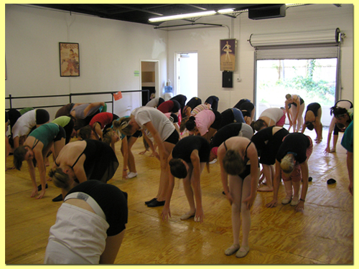
Supporting alternatives that meet their needs
Reducing impulsive decisions
  Help them to develop future plans and think about the consequences of their actions
Alternative sources of reward (sensation seeking)
  Help them develop interests that are rewarding
Activities and supports for dealing with the effects of trauma, neglect, hopelessness, and anxiety
  Social support and activities
  Encourage them to verbally express emotions

Slide 30
State the risks and encourage alternatives
Positive Expectancy | So what’s wrong with that? | What else could you do?
Have fun | Artificial high that prevents enjoyment of other things | Replace with safer and healthier choices for having fun
Feel sexier | Not how others see you Bad judgement – embarrassment Regret actions | ?????
Relax | Actually makes things worse | Replace with more effective ways of relaxing
Talk more easily | Say stupid things that you will regret | ?????
What else could you do is an exercise for the youth, ask questions,
but be ready to help answer with healthy alternatives that they would like.

Slide 31
Simple message: normative feedback
Teens often overestimate how many and how much others are doing
If your teen suggests that a lot of other people are doing something risky, then a simple message that says “Actually the research shows that very few students do ….”
Frequency of Marijuana in a Week

Slide 32
Be forgiving, but be aware!
Stages of Initiation
Non-use
Intend to use
Experimental use
Regular non-problem use
Substance abuse
Substance dependence
Universal Prevention
Targeted Prevention
Treatment

Slide 33
When should you get help
Signs of dependence
Using drugs to cope with problems, anxiety or depression

Slide 34
How and when to say it
Keep lines of communication open
Watch for teachable moments
Be persistent, but not argumentative; roll with resistance
Make positive statements
Tell the truth: don’t make things up

Slide 35
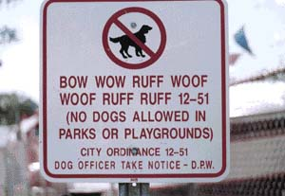
Try to speak their language

Slide 36
When to talk to them: teachable moments
Quiet times when the opportunity arises
Away from friends and siblings
In the car
Watching TV – e.g. TV commercials
When they ask questions or make statements
For example:
“Mom did you ever use marijuana?”
TV shows partying with alcohol use

Slide 37
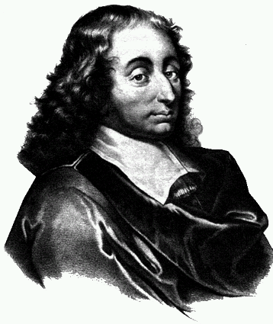
Meaningful and persuasive messages
“People are generally better persuaded by the reasons which they have themselves discovered than by those which have come into the mind of others. “
Pascal (Penses, 1662)

Slide 38
Be positive, not negative
“I am not a crook” - Richard Nixon (1972)
Thereby convincing us all that he was in fact a crook!
Our research tells us why we should not give information about the myths of alcohol or deny the positive effects of drugs and alcohol.
Rather we should contrast with facts: “I know you may have heard things about marijuana, but did you know that marijuana use:
  Messes up sex hormones – reduced testosterone in males
  Increase the risk of mental illness”

Slide 39
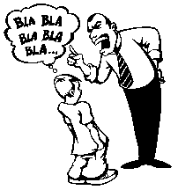
How to talk to kids
Listen first
Ask open-ended questions
Give time for thought
Be empathetic
Be prepared and tell the truth

Slide 40
They pay attention to the messenger: always tell the truth
“Despite the struggling, I got through my polio shots, and now of course I’m glad I did. But the shots did hurt. The lesson that a lot of Boomers learned from this experience was this: Grown-ups, sometimes with the best intentions, will look you right in the eye and lie. And they hadn’t even started talking to us about drugs.”
Dave Barry Turns 50 (1998)

Slide 41

Conclusion
The real war on drugs is the battle for the hearts and minds of our youth
We don’t want to prevent them from taking the journey, but we do want them prepared for challenges along the way.

