Slide 1
Anxiety: The Rise in Student Self-Medication
Doug Rogers M.Ed, MPE, CCADC, ICADC
Substance Abuse Prevention Counsellor
SD# 22 Vernon, BC, Canada
drogers@sd22.bc.ca

Slide 2
The plan for today:
What about Doug?
Define the problem
Look at some data – “you can’t solve a problem until you admit you have a problem” (in your best Dr Phil voice)
Substance Abuse as a coping mechanism
How can counsellors help kids?
Please ask questions at ANY time

Slide 3
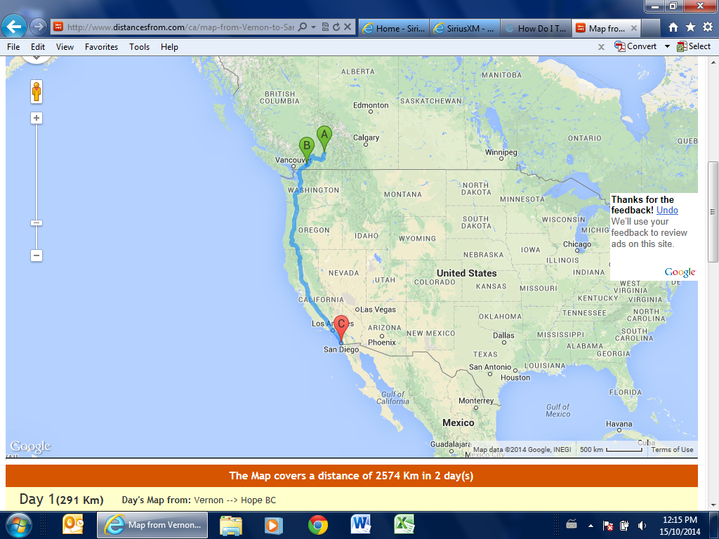
Vernon BC to San Diego

Slide 4
Things to consider:
Anxiety:
  The most abused drug?
      Food (Sugar)
  The most underused treatment?
    Exercise
    “It’s a 21st century irony, where everything you hoped for in life fills you with anxiety”.
    F**ked Up front man Damian Abraham

Slide 5
Some Definitions:
Anxiety is a general term for several disorders that cause nervousness, fear, apprehension, and worrying. These disorders affect how we feel and behave, and they can manifest real physical symptoms. Mild anxiety is vague and unsettling, while severe anxiety can be extremely debilitating, having a serious impact on daily life. Anxiety is a multisystem response to a perceived threat or danger. (medicalnewstoday.com)
* Little or no hope is another hallmark.
* Anxiety becomes a problem when our body reacts in the absence of real danger.
Teenage angst: stressful and anxious feelings. Sometimes angry, parents often caught in the middle!
Teen angst can come from many places – hair, dress, friends, phones………….
* Still hopeful.

Slide 6
How Much Anxiety is too Much?
Here are some of the signs of excess anxiety:
You feel anxious, worried, or afraid for no reason at all. Normally, teens feel anxiety because of something specific -- like a test or going out on a date. But if there's no obvious reason for your feelings, your anxiety level may be too high.
You worry too much about everyday events or activities. Some worry is normal. But if you're constantly worrying about things that are not unusual, your anxiety level is too high.
You continually check whether you did something right. While it's normal to check something you did to make sure it's right, continuing to check it again and again is a sign that you have way too much anxiety.
You're so panicky you're unable to function in certain specific situations -- like taking tests or socializing with friends.
Again, Anxiety becomes a problem when our body reacts in the absence of real danger.

Slide 7
The problem….some data
2013 study: Toronto District School Board asked students questions about their emotional well-being.
103,000 participants.
Grades 7 to 12.
The majority of students reported that they are nervous or anxious all the time.
Wake up call for parents, teachers, counselors, school boards and governments.

Slide 8
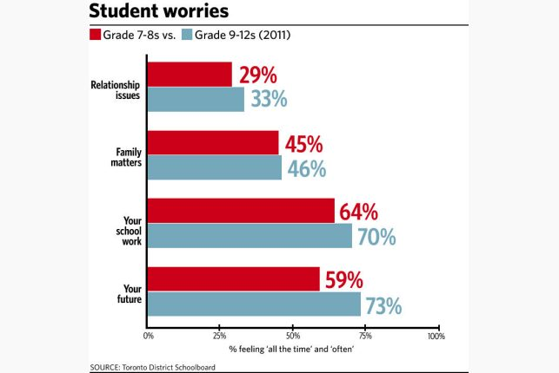

Slide 9
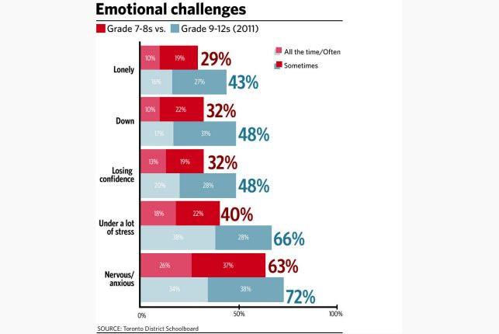

Slide 10
Frequent responses from students:
I’m scared I will never love myself.
I’m scared I will lose my mom.
I’m scared I’ll never be successful.
I’m scared I’ll never be loved.
I’m scared I won’t be successful.
Some were worried they’ll disappoint their families, others feel pressure from themselves, the school, and the media.

Slide 11
California Data:
Statistics from the National Institute of Mental Health indicate that the incidence of teen mental illness was stable for 10 years through the early 2000s, according to the latest data available (2010).
Data shows that 25 percent of teens have suffered anxiety at some time in their lives, 11.2 percent major depression and 2.4 percent agoraphobia.

Slide 12
Drug use as a coping mechanism
Mental Disorders, Substance Abuse Linked to Increase in ER Visits:
A report from the Agency for Healthcare Research and Quality (AHRQ) finds that almost one in eight of the 95 million visits to hospital emergency departments made by adults in the United States in 2007 were due to a mental health and/or substance abuse problem.
The most common reason for these visits was a mood disorder (42.7%), followed by anxiety disorders (26.1%), alcohol-related problems (22.9%), and drug disorders (17.6%). (AHRQ-HCUP Statistical Brief 92. Mental Health and Substance Abuse-Related Emergency Department Visits Among Adults, 2007. Released July 2010)
In recent years, the use of marijuana as an unofficial treatment of mental illnesses has been on the rise. The chemical properties of cannabis produce effects that can temporarily act as a mood enhancer, which may produce short-term relief of symptoms in disorders such as depression, bipolar disorder, and anxiety cluster disorders. The chemical composition of cannabis makes it an ideal short-term combatant of mood-related symptoms. Despite this, research indicates that long-term use of marijuana in conjunction with mental illness may lead to worsening of the disorder. (Addiction Treatment Magazine, 2013).

Slide 13
Drug use as a coping mechanism
California high school students’ consumption of alcohol, tobacco and illegal drugs is increasing (samhsa, 2012)
In short, kids, like adults, use drugs to help cope with the pain of life (tobacco, alcohol, marijuana, E, meth, prescription meds………)
Co-occurring illness? ( The chicken and the egg)

Slide 14
Teen Prescription Drug Abuse (drugabuse.gov, 2014)
Prescription drug abuse among teens is a significant problem affecting communities nationwide. Results from NIDA’s 2012 Monitoring the Future survey of teen drug use showed a number of worrying issues:
Nonmedical use of prescription drugs remains high, while teens’ perception of the risk of such abuse is low.
14.8% of high school seniors used a prescription drug for nonmedical reasons or one that was not prescribed for them in the past year.
After alcohol, tobacco, and marijuana, prescription and over-the-counter medications account for most of the top drugs abused by 12th graders in the past year, with Adderall and Vicodin being the most commonly abused prescription drugs.

Slide 15
Screening – using SCARED
Screen for Child Anxiety Related Disorders (SCARED)
CHILD Version—Page 1 of 2 (to be filled out by the CHILD)
Available on line – no cost.
Sample questions:
                not true somewhat true very true
1. When I feel frightened, it is hard to breathe .
2. I get headaches when I am at school.
3. I don’t like to be with people I don’t know well.
4. I get scared if I sleep away from home.
5. I worry about other people liking me.
6. When I get frightened, I feel like passing out.
Easy to score – provides insight into the problem (Not Diagnostic)

Slide 16
How can counselors help kids?
Relaxation training (Calm Breathing, Progressive Muscle Relaxation, Meditation, Mindfulness).
Get enough sleep, eat real food, exercise.
Connect with others – adult supervised activities.
Connect with nature – walk, run, get outside (away from the video games!!).
Think positively, teach realistic thinking.
Cognitive behavior therapy.
Mindfulness – here and now
Big picture – we must reduce the stigma of mental health issues. (“suck it up” is toxic!)

Slide 17
Questions???
Thank you!
Doug Rogers
Cell: 250-549-6179
drogers@sd22.bc.ca

