Slide 1
Anxiety and Depression in youth: what you can do to help them.
Marvin Krank And Lily Krank

Slide 2

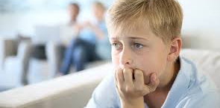
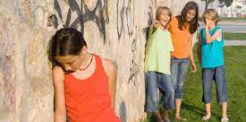
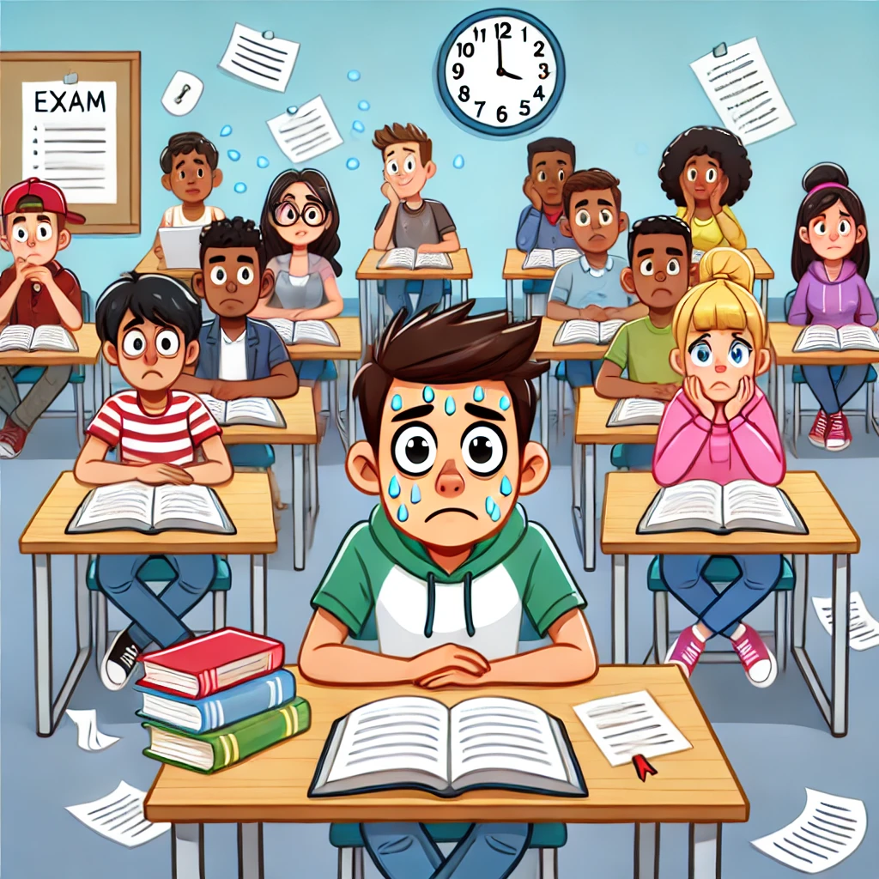
Anxiety and Depression in youth
Mental/emotional health issues often arise in school-aged children
Challenging situations can increase emotional problems

Slide 3
Anxiety is common
Everyone has anxiety - What are you afraid of?
Benefits of anxiety
1. Avoiding real danger is adaptive
2. Anxiety can be motivating
We learn fear very fast – even just one experience

Slide 4
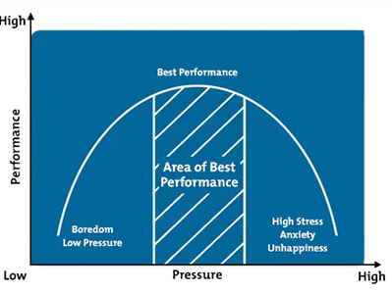
Anxiety and Performance (Inverted U-shaped curve)

Slide 5
Early signs of Anxiety Problems
Anxiety can lead to excessive worry or fear that affects daily life. Examples, like nervousness before exams or public speaking.
Signs of Anxiety:
physical symptoms (sweating, heart racing),
behavioral signs (avoiding situations),
emotional impact (feeling restless).

Slide 6

sources of problematic anxiety
Sensitivity: Some children are more sensitive to symptoms of anxiety
Stressful life experiences like bullying and ostracism
Trauma

Slide 7


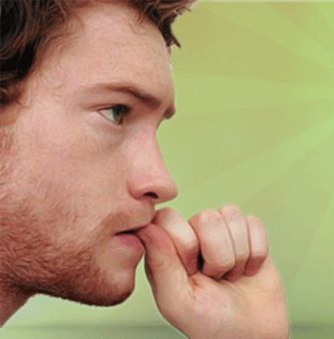


Anxiety Sensitivity (AS)

Slide 8
Early signs of anxiety sensitivity
“I get scared when I am nervous”
I get scared when I experience unusual body sensations”
It scares me when I can’t focus”
“I won't know what do”
“Everyone can see that I am nervous”

Slide 9

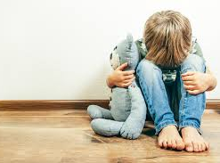
Sadness, hopelessness, Depression
Everyone gets sad
Natural reaction to stresses like loss and traumatic experiences
But sadness can become persistent – hopelessness/depression

Slide 10
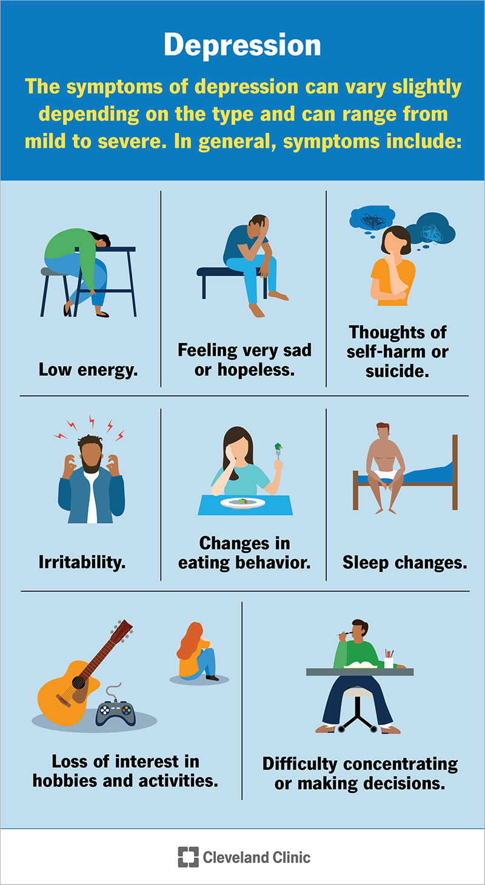
Early signs of Depression
Physical
Behavioral
Emotional
Cognitive

Slide 11
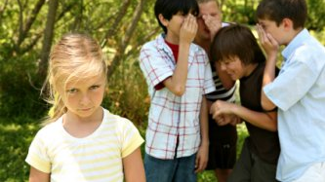
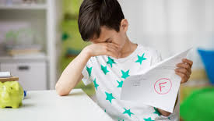
Causes of hopelessness and Depression
Negative thinking
Stressful life experiences
Failures e.g. academic/social

Slide 12


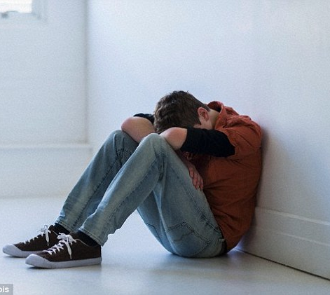
Negative Thinking (NT)
Hopelessness/ Depression

Slide 13
Early Signs of negative thinking
“I feel like I am a failure”
“I am not happy”
“My future will be disappointing”
“I am not proud of what I have done”
“I am not good enough for anyone”
“No one likes me”
“I don’t like myself”

Slide 14

How our children respond to it is the key
Coping is how we respond to difficult and challenging situations
Adaptive coping
Maladaptive coping

Slide 15
Maladaptive coping (makes the problem worse in the future)
Escape, avoidance, distraction – evading the problem or feelings
Temporary relief, but…
1) increases fear,
2) prevents success,
3) decreases resilience,
4) physical and mental harms

Slide 16
Effective coping – positive healthy coping
addressing the problem,
managing emotions,
getting and staying connected to others,
framing the experience in a positive light, healthy stress reduction
=> increases resilience and future success and
=> leads to positive and healthy outcomes

Slide 17
What can parents do to help?
Ask
Ask open ended questions
Listen
Listen – stop talking and giving advice
Nudge
Nudge – lead them to their positive solutions
Reach out
Reach out – enlist help from teachers, principals etc.
Help
Help them join activities that they like, but don’t force them
Reduce
Reduce their sense of blame (“its not your fault”)
Celebrate
Celebrate success
Model
Model positive emotions and interactions

Slide 18

What to do if things just keep getting worse
Get help from counsellors and other health professionals
Learn to
express emotions
healthy coping skills
suicide prevention

